Slide 1
Dual-mode survey of park and ride users
Kevin Stefan, HBA Specto Inc.

Slide 2
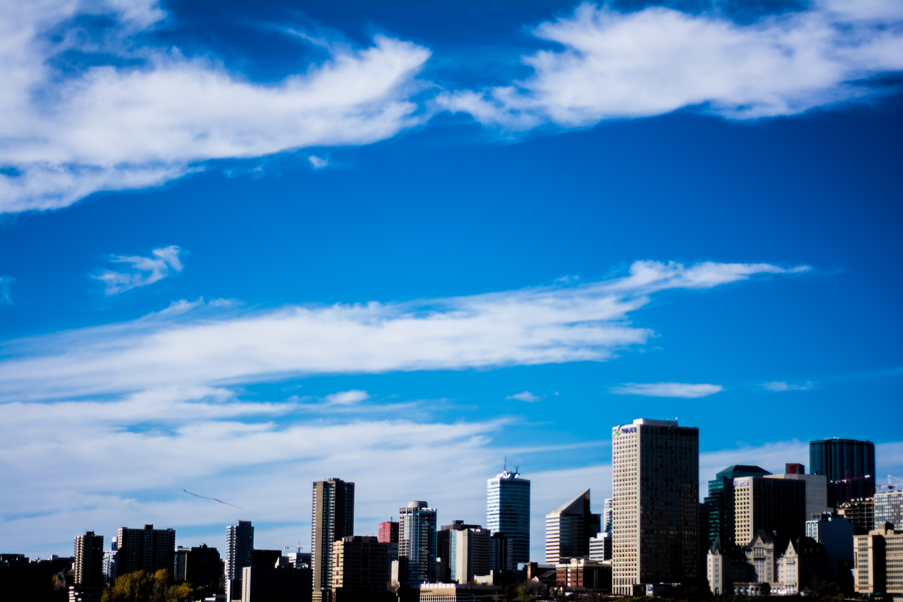
Context
Edmonton, AB, Canada:
1.3M (region) / 930K (City)
LRT system has 18 stations + 12 under construction; 113K weekday boardings
Survey:
Fall 2017 (main survey Oct 31 – Nov 10)
Revealed and stated preference aspects
In person recruitment
Online followup

Slide 3
Recruitment survey
In person recruitment during morning:
LRT stations, Transit Centres, Buses
Downtown, Postsecondary Education, Hospital
8 days, ~27 recruiters per day
Single page form – questions about trip being made
Origin, destination, purpose, mode (detail about park and ride)

Slide 4
Online Survey
Online survey host using LimeSurvey (FOSS)
General flow:
Information about trip made
Stated preference choice games
540 preloaded choice sets
Demographics

Slide 5
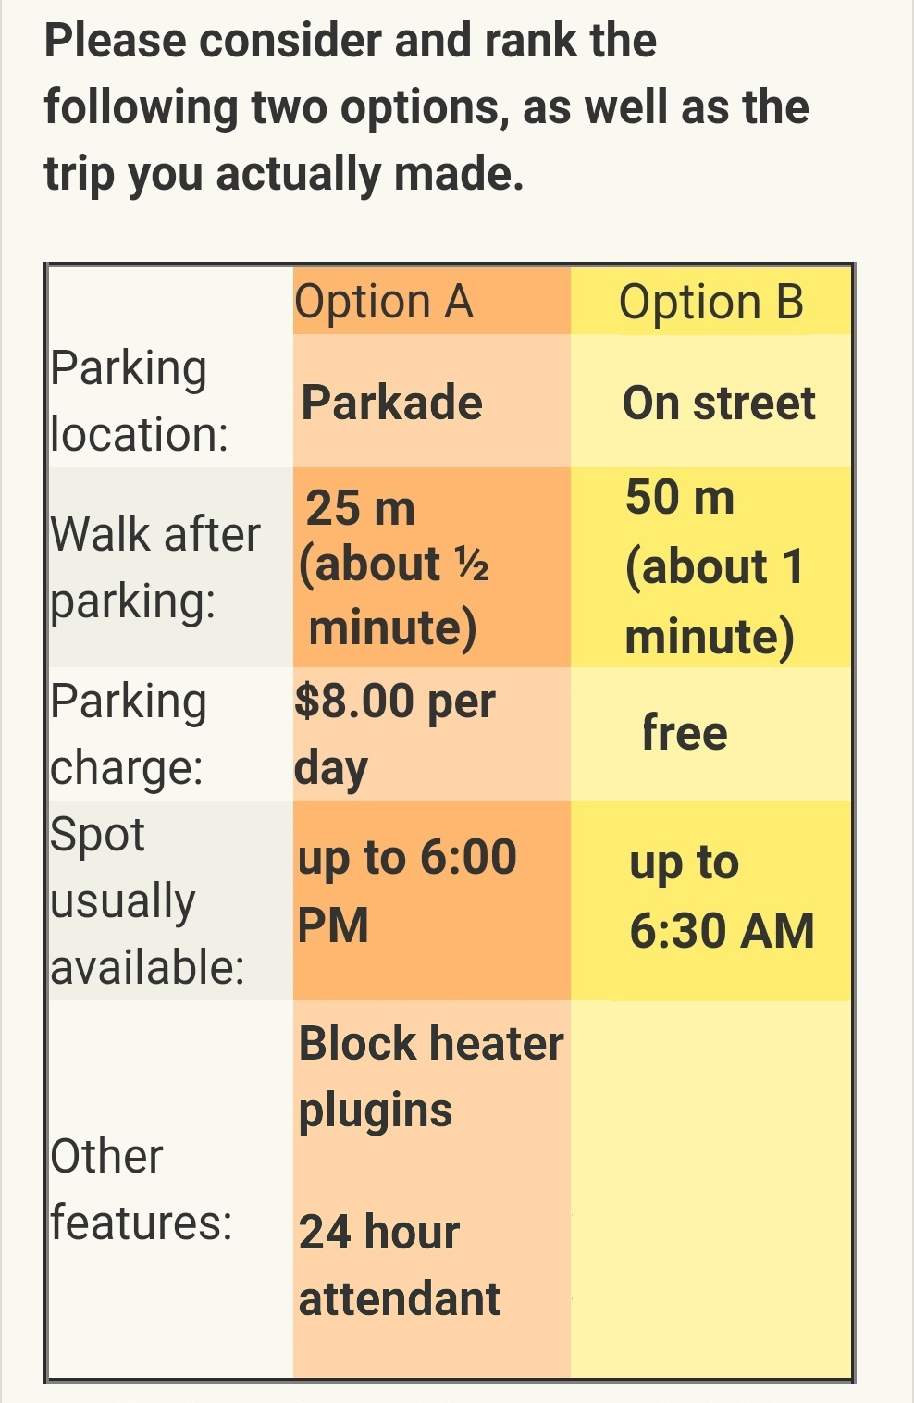
Stated preference games:
Lot type (4)
Structure, surface paved, surface gravel, on street
Walk distance (12) – 25m to 1400m, with time
Price (15) – term and cost, vary by trip purpose
Free, hourly ($1 to $5), daily ($2 to $15), monthly ($35 to 250)
Availability (9) – time of day
Other features (6) – up to 3 for any alternative

Slide 6
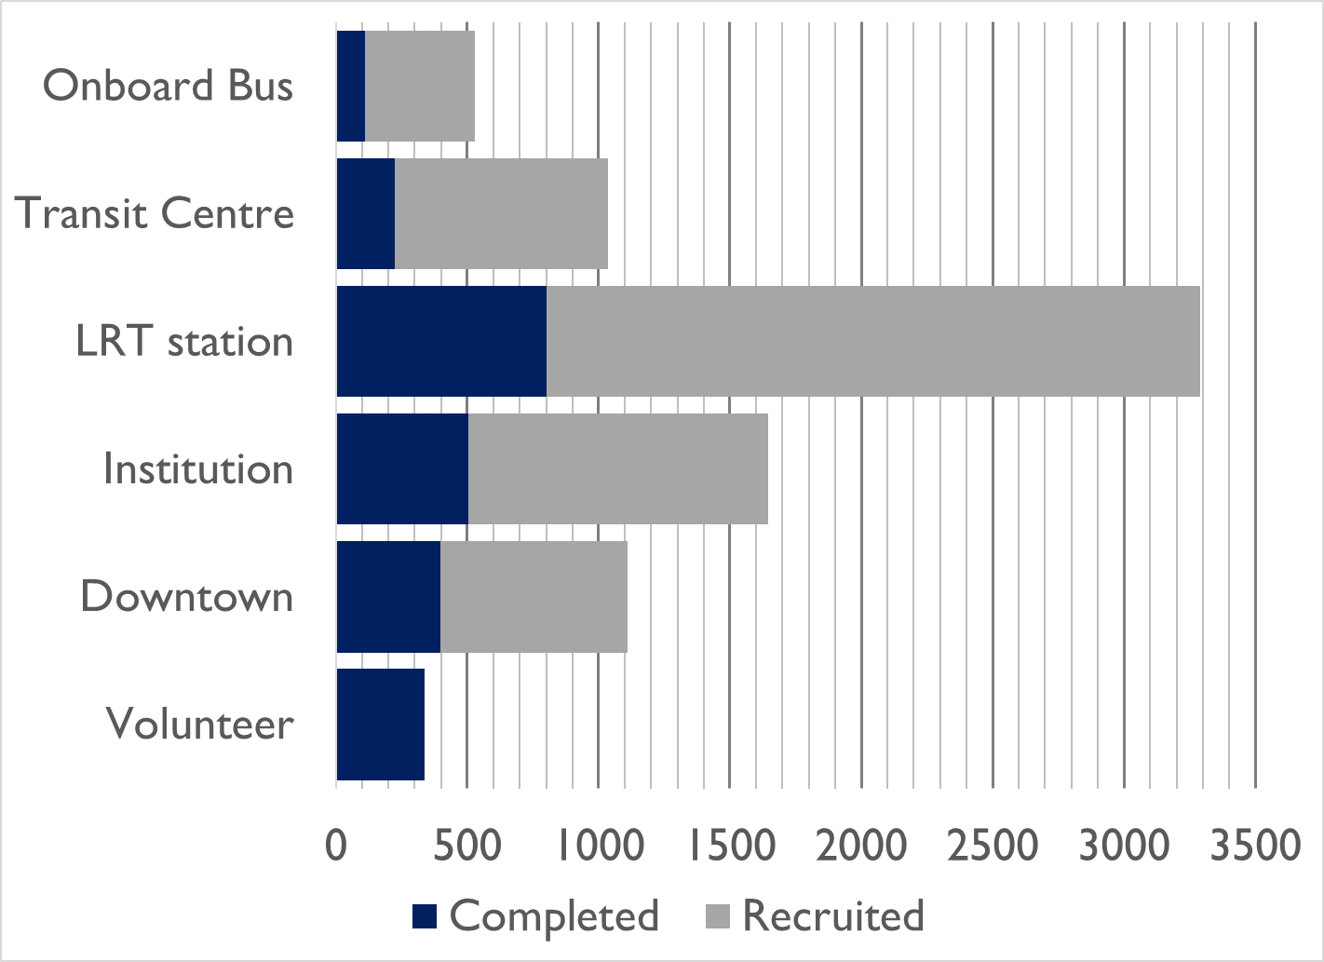
Survey Response Rates
7600 recruited; 2040 completed survey
27% completion rate
23% at transit, 33% at destinations
91% who started online survey completed
Additional 340 without ID

Slide 7
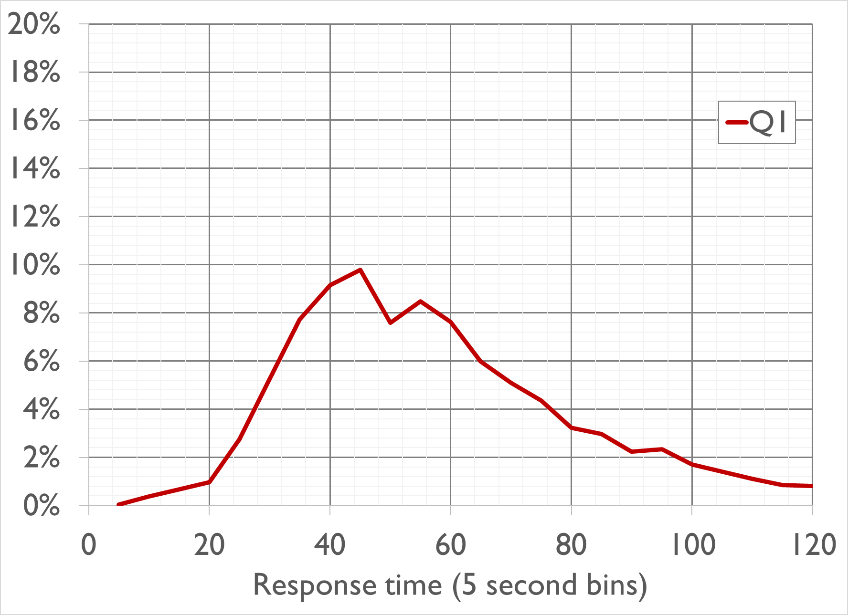
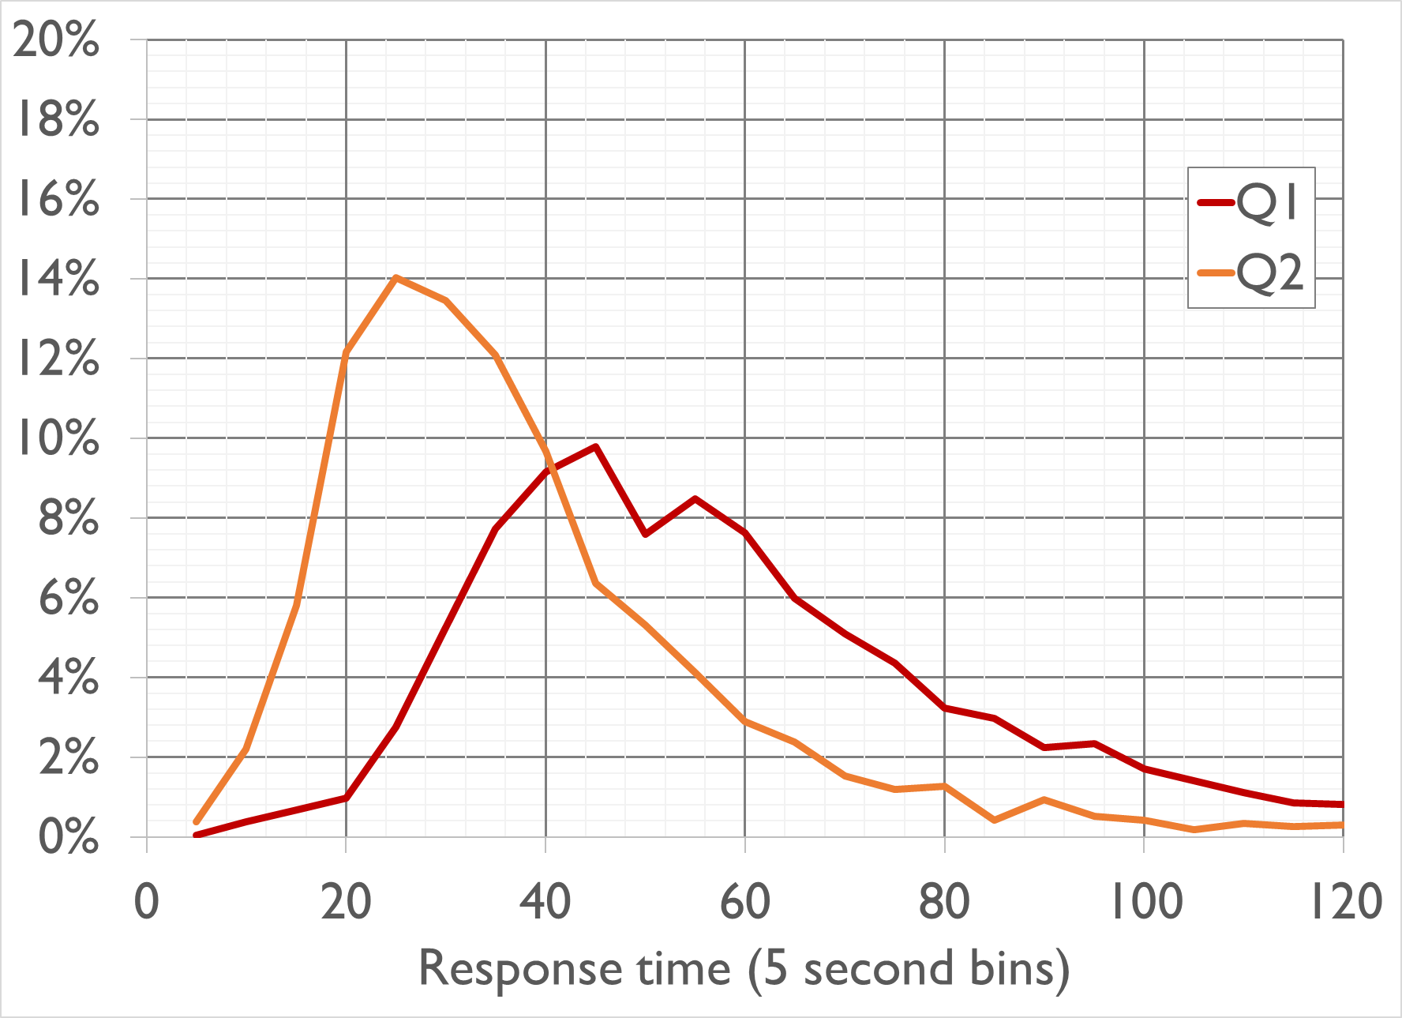
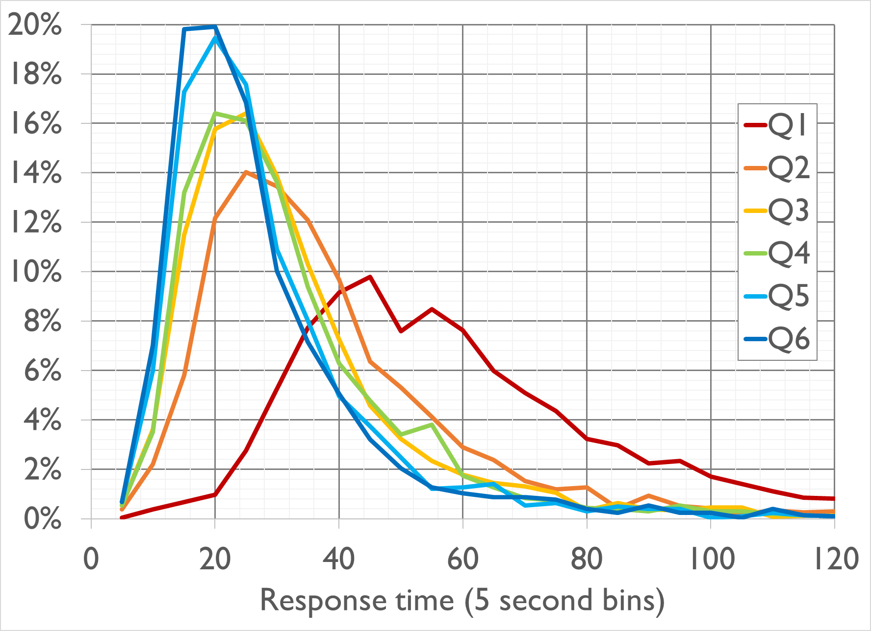
SP Response quality
Learning curve; most people paying attention
Tested quick responses in estimation; excluded 3.7%
60% same day, 20% next day response
After 3 SP questions, option to do 3 more
87% chose to do all six

Slide 8
Model estimation
Utility expressed in terms of daily cost
Monthly cost valued at 12.0 days per month (work and school)
Hourly cost valued at 3.1 hours per day (other purposes)
High income HH had about 2/3 the cost sensitivity
Not significant:
Attendants, help phones, fences
Parking in structure (vs. paved lot)

Slide 9
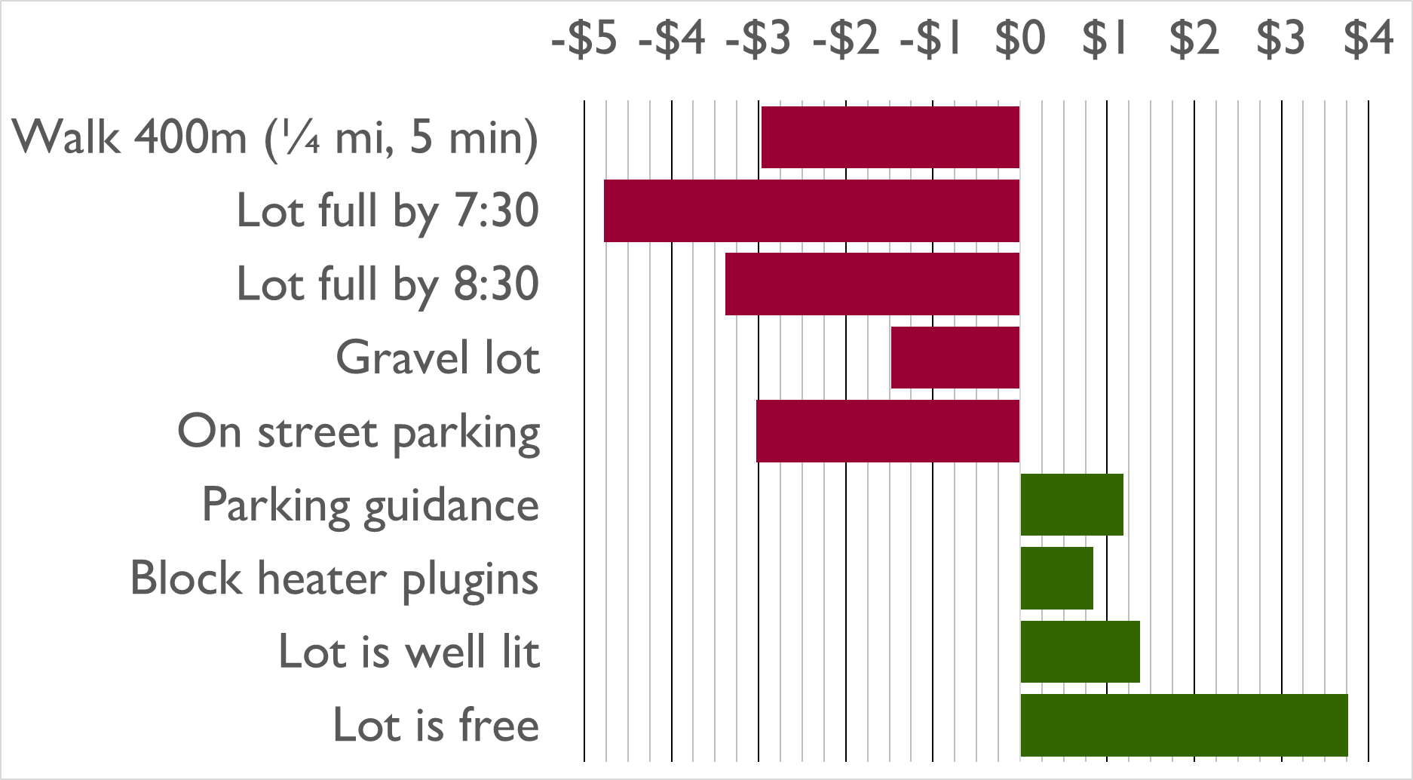

Slide 10
Learnings
Pilot useful; real-time response even more so
Changed recruitment on day-to-day basis
Dropped third week of recruitment
Still got twice as many surveys as initial goal
High response and completion rates
Volunteer responses were reasonable
Implemented utility aspects in capacity constrained park and ride model

Slide 11
Acknowledgements
City of Edmonton
Arun Bhowmick
Cherry Liu
HBA Specto
Doug Hunt
Photo by Banter Snaps on Unsplash

